Slide 1

Welcome!
Grab a drink, food, and chat with your fellow makers.
May 23, 2017

Slide 2

What is Open Hardware?
Open (Source) Hardware, or OSHW, is “hardware whose design is made publicly available so that anyone can study, modify, distribute, make, and sell the design or hardware based on that design.”

Slide 3
Introductions
Name
Day Job or whatever
Open / Hardware Experience
Non-electronics hardware project

Slide 4

Presentation:
Notes:
IoT network promising wireless sensors with 10km range on battery for 10 years

Slide 5
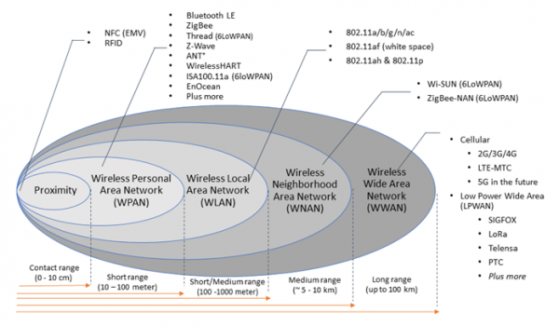
Lorawan: LPWAN
Notes:
Longest Distance: 333,7km!(207Miles) With a helium balloon at 22,6km height (14Miles)

Slide 6
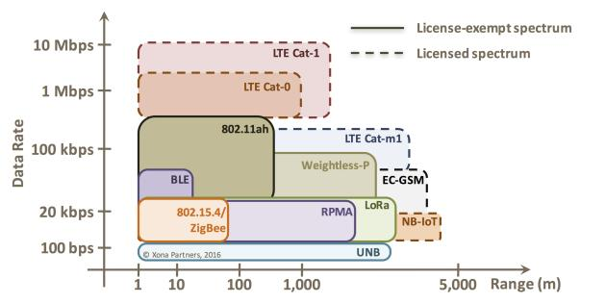
Lorawan: Crowded Space

Slide 7
Lorawan: For the Maker
Unlicensed Spectrum (US: 915 MHz)
Open Source Specification (Lora Alliance)
Open Source Software (The Things Network)
Open Source Hardware (Adafruit)

Slide 8
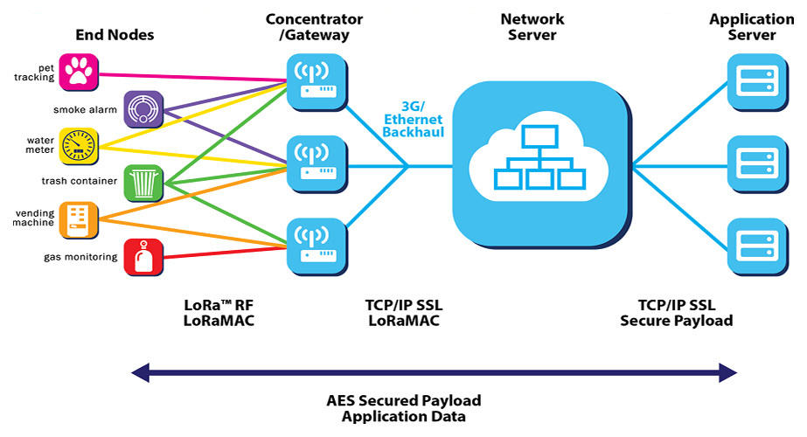
Lorawan: Structure

Slide 9
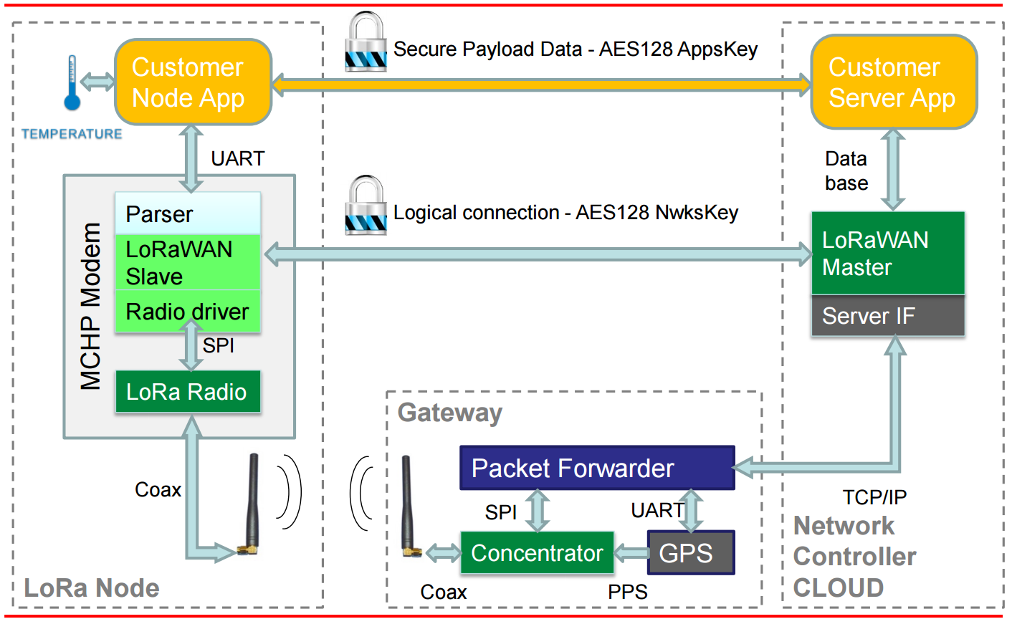
Lorawan: Security

Slide 10
Lorawan: Semtech Chips
Nodes:
SX1272/6
Microchip RN2903
HopeRF RFM95W
loriot.io/lora-end-nodes.html
Gateways:
SX1301
MultiTech MTAC-LORA
loriot.io/lora-gateways.html
Or purchase fully assembled
Notes:
Chips are only thing not open source

Slide 11
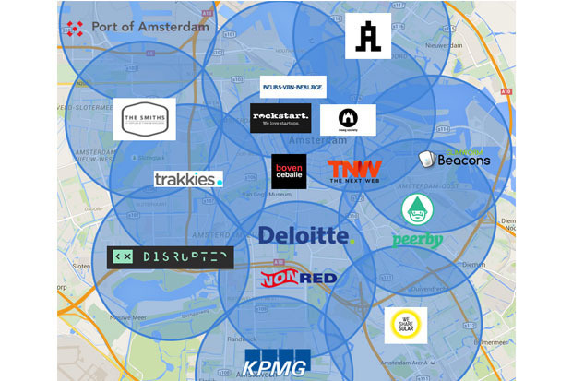
Lorawan: Goals
Notes:
End of 2015, Amsterdam crowdsourced a full network in 6 weeks. Same pop (twice the density) as Indy.

Slide 12

indyopenhardware@gmail.com
@INOpenHardware
indy-ansible-invite.herokuapp.com/she4ytoexq2uiapnsa0x
meetup.com/Indy-Open-Hardware-Meetup github.com/IndyOpenHardware

